Slide 1
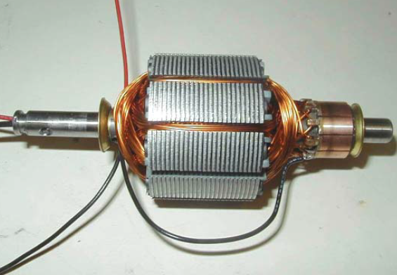
Armature Reaction And Commutation

Slide 2
Armature Reaction and Communication
Armature Reaction
Demagnetising and Crossmagnetising Conductors
Demagnetising AT per Pole
Cross – magnetising AT per pole
Compensating Windings
No. of Compensating Windings
Commutation
Methods of Improving Commutation
Resistance Commutation
E.M.F. Commutation
Interpoles or Compoles
Contd….

Slide 3
Armature Reaction
By armature reaction is meant the effect of magnetic field set up by armature current on the distribution of flux under main poles of a generator. The armature magnetic field has two effects :
It demagnetises or weakens the main flux and
It cross – magnetises or distorts it.
The first effect leads to reduced generated voltage and the second to the sparking at the brushes.
Contd….

Slide 4
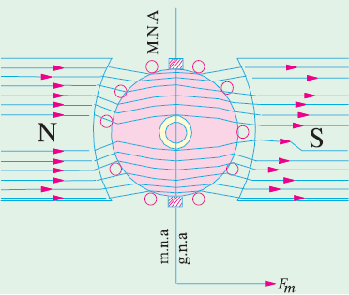
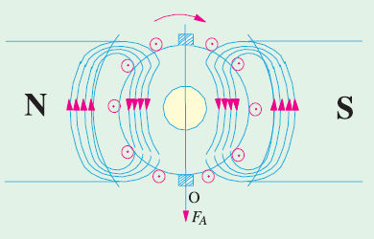
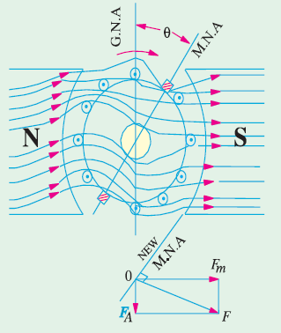
Armature Reaction
Magnetic neutral axis may be defined as the axis along which no e.m.f. is produced in the armature conductors because they then move parallel to the lines of flux.

Slide 5
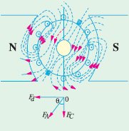
Armature Reaction
Brushes are always placed along M.N.A. Hence, M.N.A. is also called ‘axis of commutation’ because reversal of current in armature conductors takes place across this axis.
The armature m.m.f.is now represented by the vector OF_{A} which is not vertical but is inclined by an angle θ to the left.
It can now be resolved into two rectangular components, OF_{d} parallel to polar axis and OF_{C} perpendicular to this axis.

Slide 6
Armature Reaction
Component OF_{C} is at right angles to the vector OF_{m} representing the main m.m.f. It produces distortion in the main field and is hence called the cross-magnetising or distorting component of the armature reaction.
The component OF_{d} is in direct opposition of OF_{m} which represents the main m.m.f. It exerts a demagnetising influence on the main pole flux. Hence, it is called the demagnetising or weakening component of the armature reaction.

Slide 7
Demagnetising and Cross – Magnetising Conductors
The exact conductors which produce these distorting and demagnetising effects are shown in Fig. where the brush axis has been given a forward lead of θ so as to lie along the new position of M.N.A.
All conductors lying within angles AOC = BOD = 2θ at the top and bottom of the armature, are carrying current in such a direction as to send the flux through the armature from right to left.
It is these conductors which act in direct opposition to the main field and are hence called the demagnetising armature conductors.
Contd….

Slide 8
Demagnetising and Cross – Magnetising Conductors
Now consider the remaining armature conductors lying between angles AOD and COB. As shown in Fig., these conductors carry current in such a direction as to produce a combined flux pointing vertically downwards i.e. at right angles to the main flux.
This results in distortion of the main field. Hence, these conductors are known as cross-magnetising conductors and constitute distorting ampere-conductors.
Contd….

Slide 9
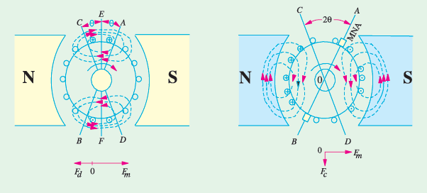
Demagnetising and Cross – Magnetising Conductors

Slide 10
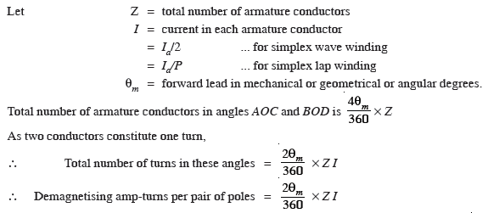
Demagnetising AT per Pole
Since armature demagnetising ampere-turns are neutralized by adding extra ampere-turns to the main field winding, it is essential to calculate their number. But before proceeding further, it should be remembered that the number of turns is equal to half the number of conductors because two conductors-constitute one turn.

Slide 11


Demagnetising AT per Pole

Slide 12
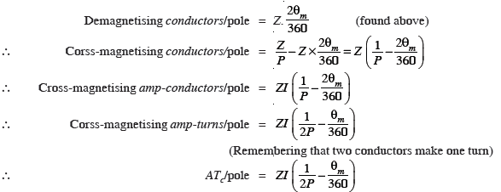
Cross – Magnetising AT Per Pole
The conductors lying between angles AOD and BOC constitute what are known as distorting or cross-magnetising conductors. Their number is found as under :
Total armature-conductors/pole both cross and demagnetising = Z / P

Slide 13
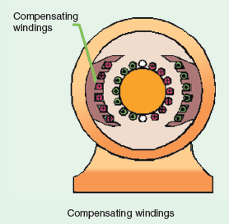
Compensating Windings
These are used for large direct current machines which are subjected to large fluctuations in load i.e. rolling mill motors and turbo- generators etc.
Their function is to neutralize the cross magnetizing effect of armature reaction.

Slide 14
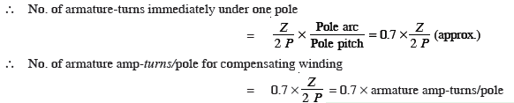
No. of Compensating Windings

Slide 15
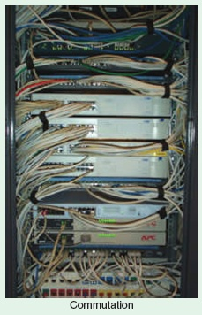
Commutation
Currents induced in armature conductors of a d.c. generator are alternating.
To make their flow unidirectional in the external circuit, we need a commutator.
Moreover, these currents flow in one direction when armature conductors are under N-pole and in the opposite direction when they are under S-pole.

Slide 16
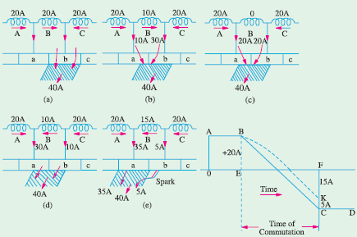
Commutation

Slide 17
Methods of Improving Commutation
There are two practical ways of improving commutation i.e. of making current reversal in the short-circuited coil as sparkless as possible. These methods are known as
Resistance commutation
E.M.F. commutation (which is done with the help of either brush lead or interpoles, usually the later).

Slide 18
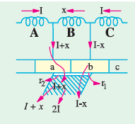
Resistance Commutation
This method of improving commutation
consists of replacing low-resistance Cu
brushes by comparatively high-resistance
carbon brushes.
From Fig., it is seen that when current I from coil’ C reaches the commutator segment b, it has two parallel paths open to it. The first part is straight from bar ‘b’ to the brush and the other parallel path is via the short-circuited coil B to bar ‘a’ and then to the brush.

Slide 19
E.M.F. Commutation
In this method, arrangement is made to neutralize the reactance voltage by producing a reversing e.m.f. in the short-circuited coil under commutation. This reversing e.m.f., as the name shows, is an e.m.f. in opposition to the reactance voltage.
The reversing e.m.f. may be produced in two ways :
either by giving the brushes a forward lead sufficient enough to bring the short-circuited coil under the influence of next pole of opposite polarity or
by using interpoles.

Slide 20
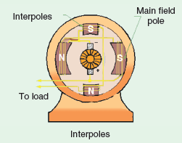
Interpoles of Compoles
These are small poles fixed to the yoke and spaced in between the main poles.
They are wound with comparatively few heavy gauge Cu wire turns and are connected in series with the armature so that they carry full armature current.
Their polarity, in the case of a generator, is the same as that of the main pole ahead in the direction of rotation.

